Slide 1

Evaluating Benchmarks for SGD Classifier
Landon Buell
14 Feb 2020

Slide 2
Classification Benchmarks
Confusion Matrix, Precision, Recall, F1 Score

Slide 3
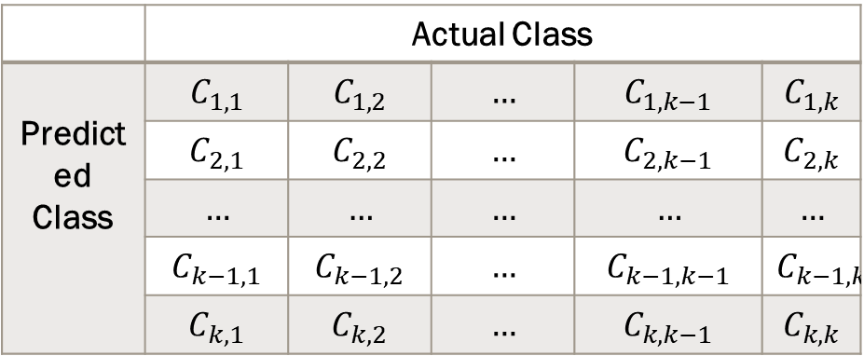
Confusion Matrix
(K x K) matrix for a K-Bins classifier
(Petrik)
Columns are actual values
Rows are predicted values
A Good classifier has a strong main diagonal
 | Actual Class
Predicted Class | $$C_{1,1}$$ | $$C_{1,2}$$ | $$…$$ | $$C_{1,k−1}$$ | $$C_{1,k}$$
 | $$C_{2,1}$$ | $$C_{2,2}$$ | $$…$$ | $$C_{2,k−1}$$ | $$C_{2,k}$$
 | $$…$$ | $$…$$ | $$…$$ | $$…$$ | $$…$$
 | $$C_{k−1,1}$$ | $$C_{k−1,2}$$ | $$…$$ | $$C_{k−1,k−1}$$ | $$C_{k−1,k}$$
 | $$C_{k,1}$$ | $$C_{k,2}$$ | $$…$$ | $$C_{k,k−1}$$ | $$C_{k,k}$$

Slide 4

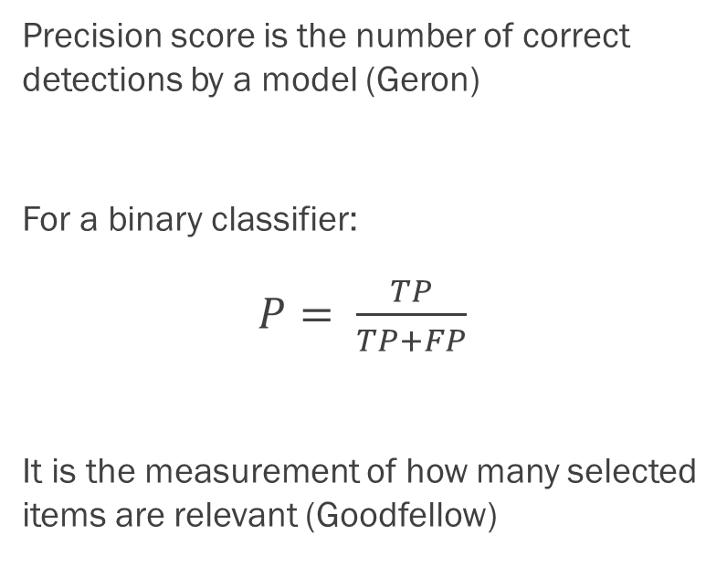
Precision Score
Precision score is the number of correct detections by a model (Geron)
For a binary classifier:
$P= \frac{TP}{TP+FP}$
It is the measurement of how many selected items are relevant (Goodfellow)
For a K-Folds Classifier:
Precision for n-th class:
$P_{n}= \frac{C_{n,n}}{\sum_{i=1}^{k}{C_{i,n}}}$

Slide 5

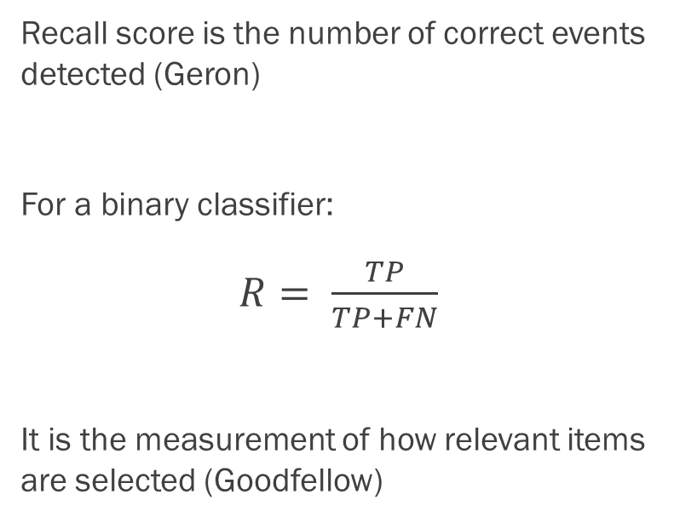
Recall Score
Recall score is the number of correct events detected (Geron)
For a binary classifier:
$R= \frac{TP}{TP+FN}$
It is the measurement of how relevant items are selected (Goodfellow)
For a K-Folds Classifier:
Precision for n-th class:
$P_{n}= \frac{C_{n,n}}{\sum_{i=1}^{k}{C_{n,i}}}$

Slide 6

F1 Score
F1 score is the harmonic mean of precision and recall, bounded on [0,1]
For a binary classifier:
$F1=2\left(\frac{P×R}{P+R }\right)$
It is the measurement of how relevant items are selected (Goodfellow)

Slide 7
Stochastic Gradient Descent Classifier
“The Heart of All Learning Algorithms” (Goodfellow)

Slide 8
SGD Classifier
Basic Linear Model Classifier –
very power & very slow
Many algorithms use some variation of this (Goodfellow)
Uses the gradient of a decision function to create an optimal set of parameters for classifier (Sanderson)
(See Sklean.linear_model)

Slide 9
MNIST DATA
Collection of 70,000 images of hand-written figures
Arranged into (28 x 28) pixel arrays
For this test, I use the first 10,000 images
Split into 8,000 training figures, 2,000 testing figures
Permutated w/ numpy library to ensure ‘randomness’

Slide 10

Gaussian Noise
Pseudo-Random noise is added to each image – Drawn from Gaussian
$𝒩\left(μ,σ\right)= \frac{1}{\sqrt{2πσ^{2}}}e^{−\frac{{\left(x−μ\right)}^{2}}{2σ^{2}}}$
This is a common approximation for error in regression functions (James)

Slide 11
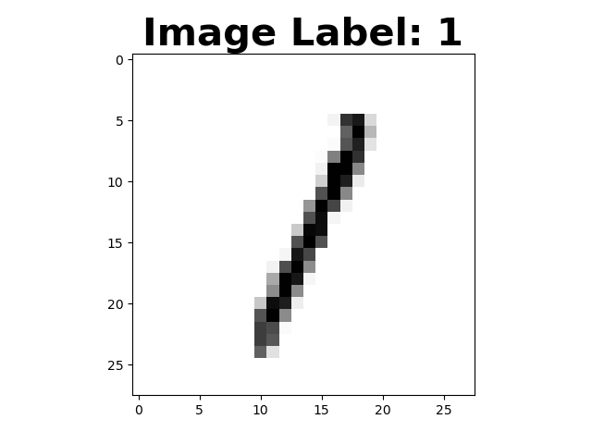
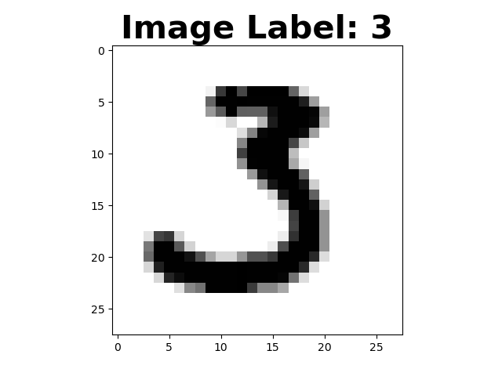
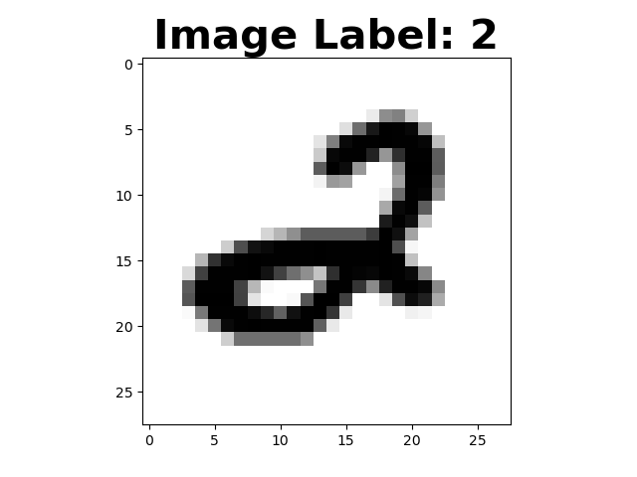
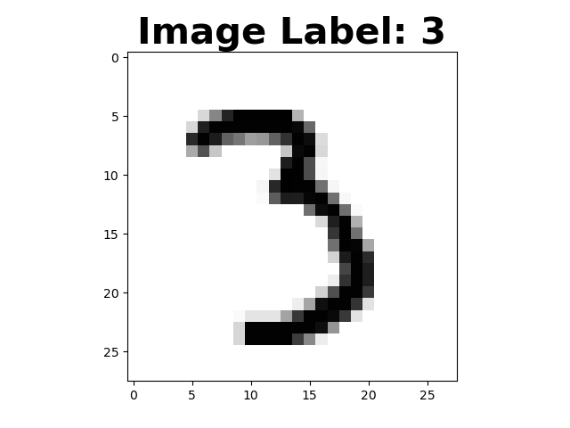
The Control Classifier
Training samples
Testing Samples

Slide 12
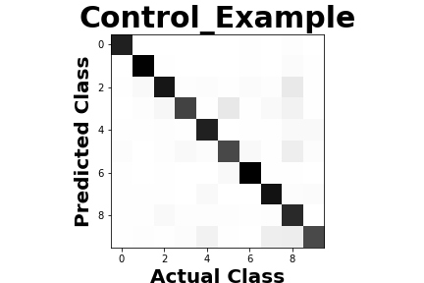
Results - Control
Average Precision: 0.8716
Average Recall: 0.8669
Average F1: 0.8663

Slide 13
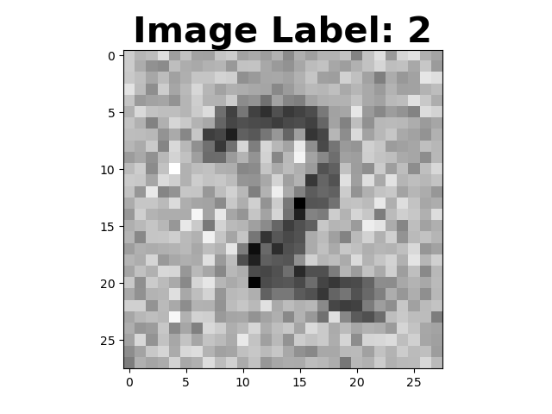
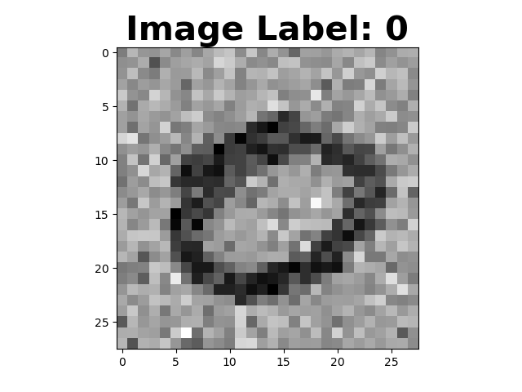
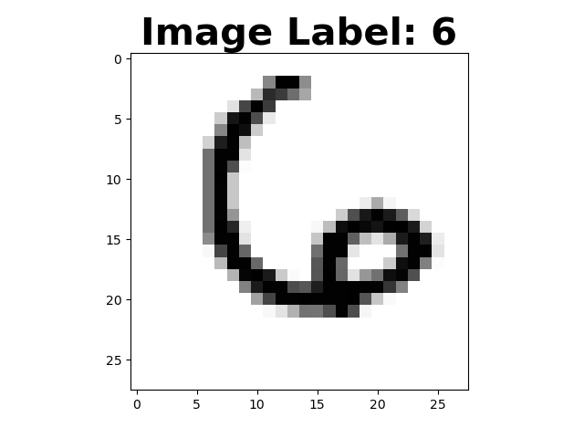
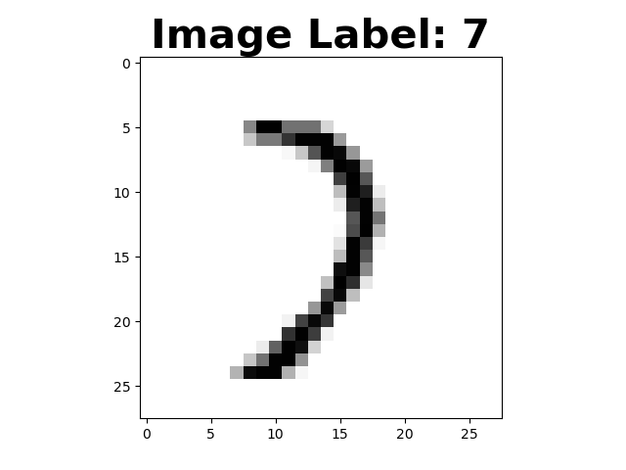
The Noisy – Clean Classifier
0.8663
0.8663
Training Samples
Testing Samples

Slide 14
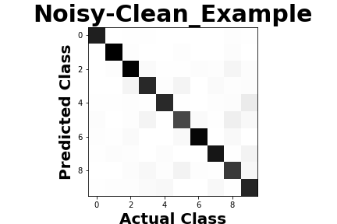
Results – Noisy - Clean
Average Precision: 0.8889
Average Recall: 0.8823
Average F1: 0.8829

Slide 15
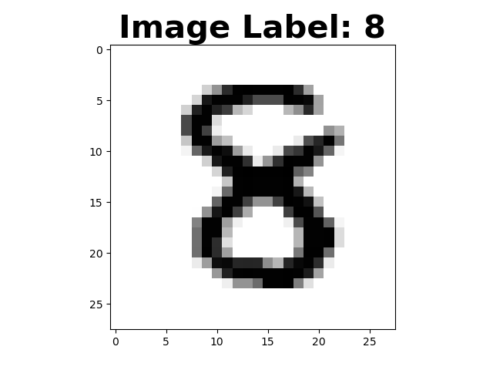
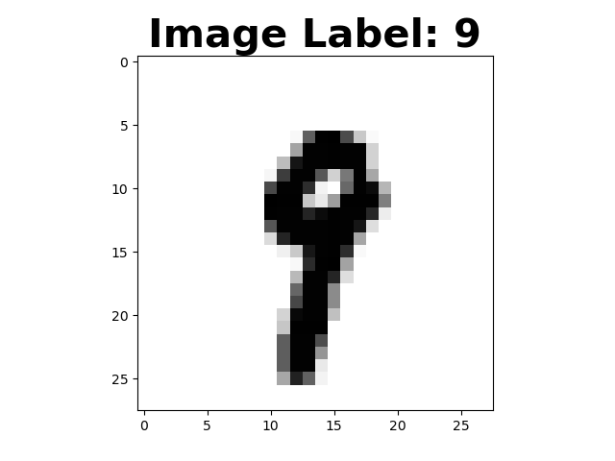
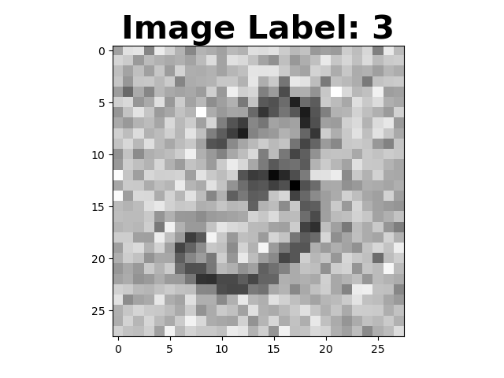
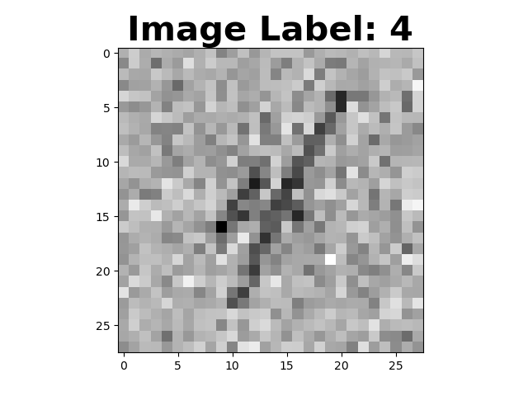
The Clean – Noisy Classifier
Training Samples
Testing Samples

Slide 16
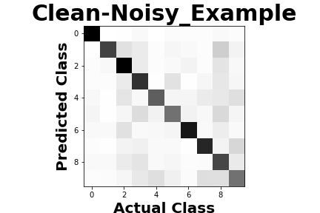
Results – Clean - Noisy
Average Precision: 0.6620
Average Recall: 0.6428
Average F1: 0.6641

Slide 17
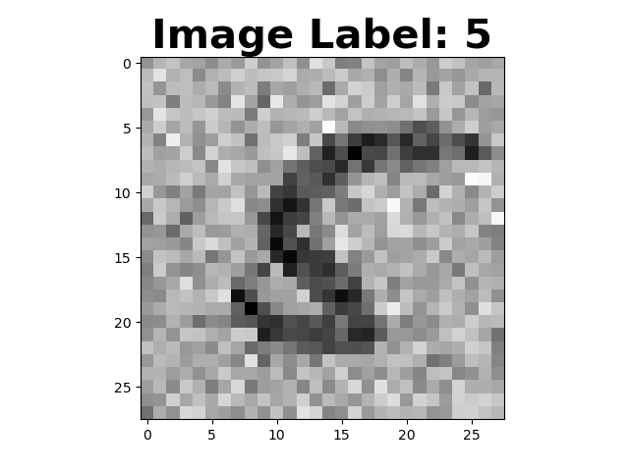
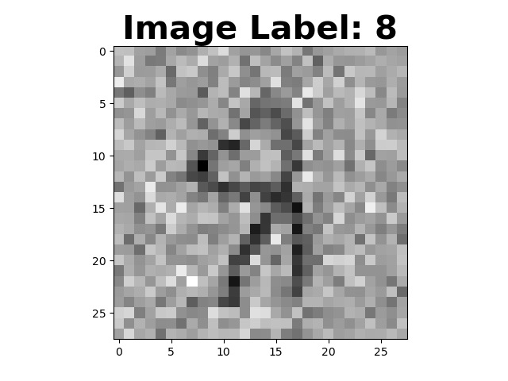
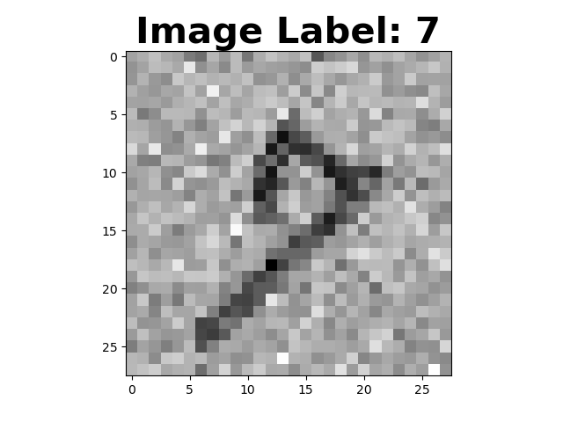
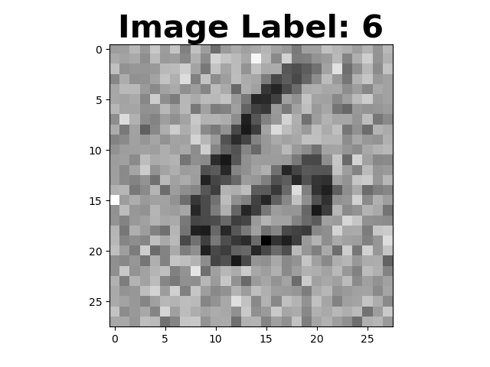
The Noisy Classifier
Training Samples
Testing Samples

Slide 18
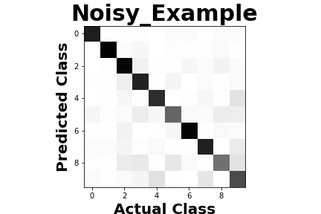
Results – Noisy
Average Precision: 0.7948
Average Recall: 0.7895
Average F1: 0.7898

Slide 19
What Next?
Run program for more epochs
Vary size of data sets
Different types of noise added into features
New Metrics
New data set (CFAR, IRIS,etc…)

Slide 20
Citations
Geron Aurelien. Hands-on Machine Learning with Scikit-Learn and TensorFlow: Concepts, Tools, and Techniques to Build Intelligent Systems. O’Reilly, 2017.
Goodfellow, Ian, et al.Deep Learning. MIT Press, 2017.
James, Gareth, et al. An Introduction to Statistical Learning with Applications in R. Springer, 2017.
Olsen, R.S., et al. 2017. ’PMLB: A Large Benchmarking Suite for Machine Learning Evaluation and Comparison’. Biodata Mining
Petrik, Marek. “Introduction to Machine Learning.” Machine Learning. 05 Feb. 2020, Durham, New Hampshire
Sanderson, Grant. But What Is A Neural Network? 3Blue1Brown, www.3blue1brown.com/neural-networks.

